Slide 1
Concurrency Control: Introduction to Threads and Threading API
Dr. Muhammad Saeed

Slide 2
Outlines
Multitasking vs Multithreading
What is a thread?
Threads vs Processes
Why Multithreading
Why use threads?
Example Code
Issues that need to be address in Multithreading
Accessing shared global variable
Why output is different?
Race condition and atomicity
Thread APIs
Summary

Slide 3
Multitasking vs Multithreading

Slide 4
What is a thread?
Thread is an independent path of execution
In a multi-threaded program, each thread has its own PC, register (context), stack, but it shares the process’s address space
#include <stdio.h>
int main(int argc, char *argv[])
{
printf("hello world\n");
return 0;
}
main thread

Slide 5
Threads vs Processes
Threads are like processes:
They can execute independently
Each thread has a separate PC and set of registers (context) while executing
If two threads T1 & T2 are running on a single processor then:
Only one can run at any given time
Switching from on thread to other requires a context switch
Each thread has its own stack (thread local storage)

Slide 6
Threads vs Processes
Threads are different than processes:
Threads share the same address space
Context switch b/w threads results in switching of stacks but not of page tables!
A single process can have one or more threads
Thread states are saved in Thread Control Blocks (TCBs) instead of PCBs

Slide 7
Single vs Multi-threaded Address Spaces

Slide 8
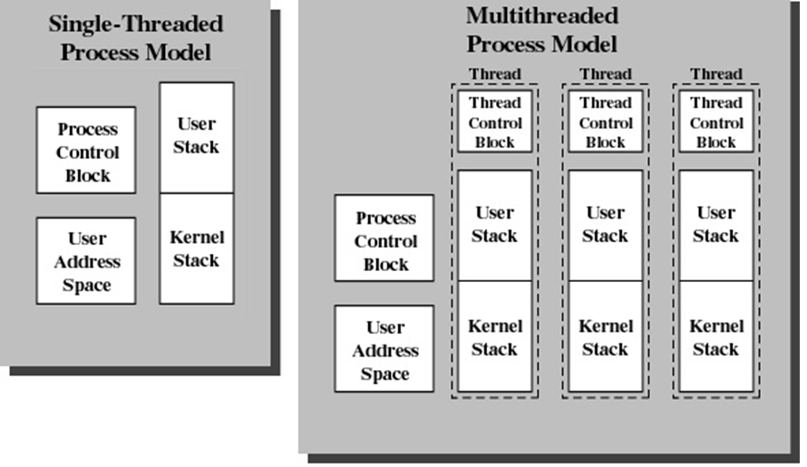
Multitasking vs Multithreading

Slide 9
Why Multithreading

Slide 10
Why use threads?
Parallelism
Better exploit multi-core CPUs
Blocking I/O
When doing a blocking I/O operation, only one thread gets blocked!
Overlap I/O with other activities within a process
Same could be achieved via multiple processes but this approach is costly in terms of memory and time.
Threads are extensively used in Web servers, DBMSs, etc.

Slide 11
Creation Time
50,000 processes or threads creation time in seconds
Platform | fork() | pthread_create()
Intel 2.6 GHz Xeon E5-2670 (16cpus/node) | 8.1 | 0.9
Intel 2.8 GHz Xeon 5660 (12cpus/node) | 4.4 | 0.7
AMD 2.3 GHz Opteron (16cpus/node) | 12.5 | 1.2
AMD 2.4 GHz Opteron (8cpus/node) | 17.6 | 1.4
IBM 4.0 GHz POWER6 (8cpus/node) | 9.5 | 1.6
IBM 1.9 GHz POWER5 p5-575 (8cpus/node) | 64.2 | 1.7
IBM 1.5 GHz POWER4 (8cpus/node) | 104.5 | 2.1
INTEL 2.4 GHz Xeon (2 cpus/node) | 54.9 | 1.6
INTEL 1.4 GHz Itanium2 (4 cpus/node) | 54.5 | 2

Slide 12
Benefits of Threads
Less time to
create a new thread than a process
terminate a thread than a process
switch between two threads within the same process
Low Memory Requirements than Multiprogramming
Since threads within the same process share memory and files, they can communicate with each other without invoking the kernel

Slide 13
Example Code

Slide 14
Threads: Example Code
#include <stdio.h> #include <pthread.h>
#include “common.h”
#include “common_threads.h”
void *mythread(void* args) {
print(“%s\n”, (char*) args);
return NULL;
}
int main(int argc, char *argv[])
{
pthread_t p1, p2;
printf(“main begin\n");
Pthread_create(&p1, NULL, mythread, “A”);
Pthread_create(&p2, NULL, mythread, “B”);
Pthread_join(p1, NULL);
Pthread_join(p2, NULL);
printf(“main end\n");
return 0;
}
main thread
p1
p2

Slide 15
CPU Scheduling Output
Output is dependent on which thread is created and which is scheduled first on the CPU

Slide 16
Issues that need to be addressed in Multithreading
Race Condition
Atomicity
Mutual Exclusion
Synchronization

Slide 17
Threads – accessing shared global variable

Slide 18
Threads – accessing shared global variable

Slide 19
Expected Output

Slide 20
Actual Output
Non-deterministic output
On multiple runs, counter is ≠ 20000000

Slide 21
Why is the output different
Bone of contention (race condition/data race)
counter=counter+1
During execution, an interrupt might preempt a running thread
On resumption, the thread might get a stale state of shared variable and may modify it wrongly

Slide 22
Why is the output different?

Slide 23
Race conditions
The result of a program is indeterminate
It depends on the sequence in which the instructions are scheduled!
Critical section:
A portion of code which, if executed by multiple threads, can result in race condition
Usually accesses a shared resource
Should not be executed concurrently by more than one thread (mutual exclusion)
Solution
Atomic operations or atomicity
Synchronization

Slide 24
Atomicity
Mutual exclusion can be achieved if critical sections are executed atomically.
Atomic operations are executed as “all or nothing”
i.e. they cannot be interrupted half way.
Databases have similar concepts – transactions.

Slide 25
Operating System – the first concurrent program
Multiple processes run concurrently
Let’s say two processes try to append to a file
Possible problems?
Interrupts!!
All OS data structures are shared b/w processes
Codes that update these shared data structures are critical sections

Slide 26
Thread APIs
Thread Management
Mutual Exclusion
Synchronization

Slide 27
pthread API
Simple API that allows creation of threads
To use
#include <pthread.h>
add –pthread option at compilation to gcc
Provides many useful thread functions and synchronization primitives (locks, condition variables etc.)

Slide 28
Thread functions
Thread creation
thread completion (thread joining to main thread)

Slide 29
Thread - Passing arguments

Slide 30
Thread – Returning values

Slide 31
Thread – Avoid returning values of local variables

Slide 32
Locks
Initialization function
Deletion function
Lock Usage

Slide 33
Condition Variables
Provide signaling between threads so if one thread is waiting on some shared data, it may signal the other threads when it releases the shared resource
Works with locks
Usage

Slide 34
Summary
We have seen what threads are and how they relate to processes
We saw how we may create multithreaded programs using the pthreads API
We saw some issues that might pop up during multithreaded programs
Race conditions
We looked at how these are avoided through synchronization (locks, condition variables) and atomic operations

